Slide 1
Apple Watch, Electric Cars and the Surpassing of Humanity
Steve Wozniak co-founder of Apple says Apple should start making cars, that he'll buy the cheapest Apple Watch, and accepts that overly smart computers could become dangerous for humanity.

Slide 2
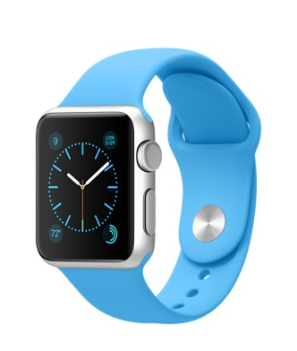
Apple Watch
"The fact is the difference between a $10,000 watch and a $17,000 dollar watch is only the band, and for an engineer like me I don't live in that world, that's not my world.” -Wozniak

Slide 3
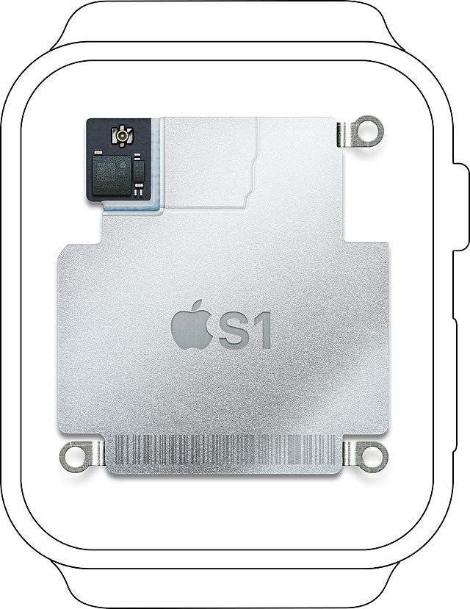
About Apple Watch
Operating System:
Watch OS
System in Package:
Apple S1
Memory: 512MB RAM
Storage: 8GB
Apple uses a customized application processor that together with memory, storage and support processors for wireless connectivity, sensors and I/O constitute a complete computer in a single package

Slide 4
Developing on Apple Watch
WatchKit: Get iPhone Apps compatible on Apple Watch
WatchKit apps have two parts: A WatchKit extension that runs on iPhone and a set of user interface resources that are installed on Apple Watch. When your app is launched on Apple Watch, the WatchKit extension on iPhone runs in the background to update the user interface and respond to user interactions.

Slide 5
How well is the selling?
Only 22 percent of US customers who preordered the Apple Watch received their devices in the first weekend it was available
More than 2 million Apple watches were preordered in the two weeks leading up to the April 24 launch. All other smartwatch vendors combined shipped only 4.6 million devices in all of 2014
Apple will ship 15.4 million Apple Watch units in 2015, giving the company 54.8 percent of smartwatch market

Slide 6
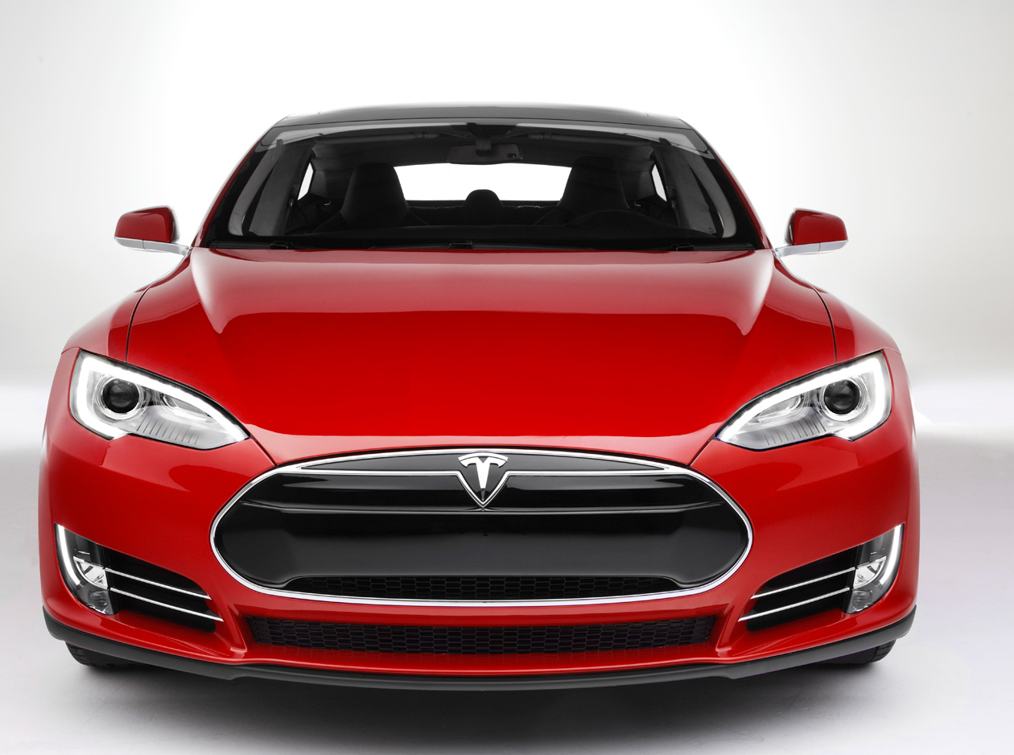
Electric Cars
"There are an awful lot of companies right now who are playing with electric cars and there's a lot more playing with self-driving cars, this is the future and it might be huge.” -Wozniak

Slide 7
About Electric Cars
Key Components: electric motor, motor’s controller, battery
Advantages:
Electric drive vehicles have on-board efficiency of around 80%.
Electric motors have very flat torque curves down to zero speed.
Electric cars significantly reduce local air pollution, and do not emit volatile organic compounds, carbon monoxide, lead and etc.

Slide 8
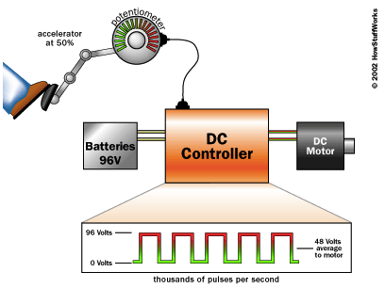
Controllers
DC Controller
AC Controller

Slide 9
Sales of Tesla Motors, Inc.
Tesla operates stores or galleries—usually located in shopping malls—in 22 U.S. states and Washington DC.
Customers cannot purchase vehicles from the stores, but must order them on the Tesla Motors website instead.
As of March 2015, Tesla Motors has delivered about 70,000 electric cars since 2008.
Reservations within the first few weeks were over 50,000 units of the PowerWall (US$179 million), and 25,000 units for the PowerPack (US$625 million), at combined orders of US$800 million.
In June 2014, Tesla Motors announced it was making its patent open source freely available to speed up production of electric cars and spur competition, at a time that electric cars comprised less than 1% of all automobiles sold in the United States.

Slide 10
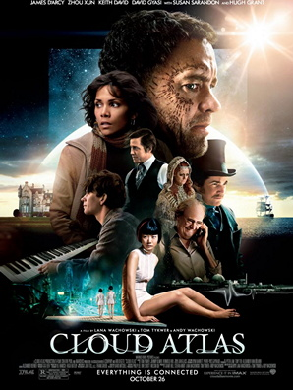
Technology & Humanity
"Like people including Stephen Hawking and Elon Musk have predicted, I agree that the future is scary and very bad for people. If we build these devices to take care of everything for us, eventually they'll think faster than us and they'll get rid of the slow humans to run companies more efficiently,” -Wozniak

Slide 11
References
“Apple co-founder Steve Wozniak on the Apple Watch, electric cars and the surpassing of humanity” (2015-03-23): http://www.afr.com/technology/apple-cofounder-steve-wozniak-on-the-apple-watch-electric-cars-and-the-surpassing-of-humanity-20150323-1m3xxk
Apple S1: https://en.wikipedia.org/wiki/Apple_S1
WatchKit: https://developer.apple.com/watchkit/
Apple Watch Sale Situation: https://www.cnet.com/news/how-well-did-the-apple-watch-sell-tim-cook-remains-mum/
“How Electric Cars Work”: http://auto.howstuffworks.com/electric-car.htm
“Quantum Computing”: http://en.wikipedia.org/wiki/Quantum_computing
“How Quantum Computers Work”: http://computer.howstuffworks.com/quantum-computer.htm
"China implements radical railway reform". International Railway Journal, 2013-08-02
Nuclear Energy Institute Website, 2009-02-23

